Slide 1
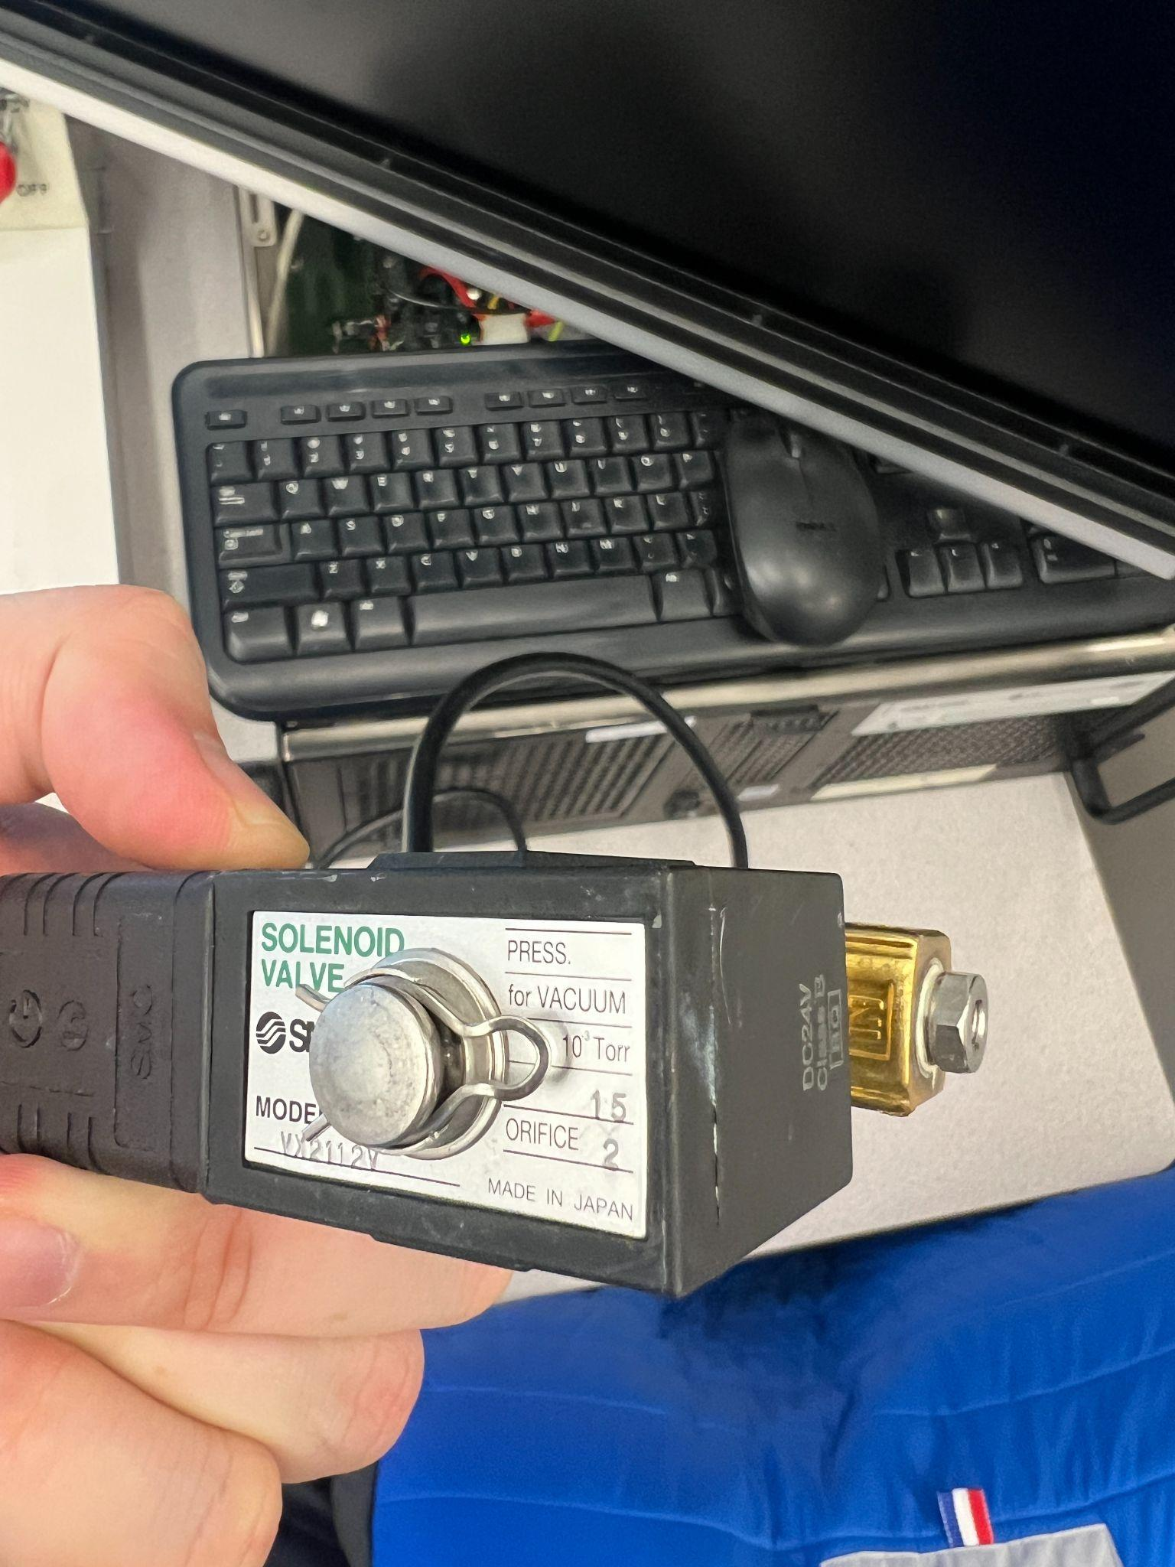
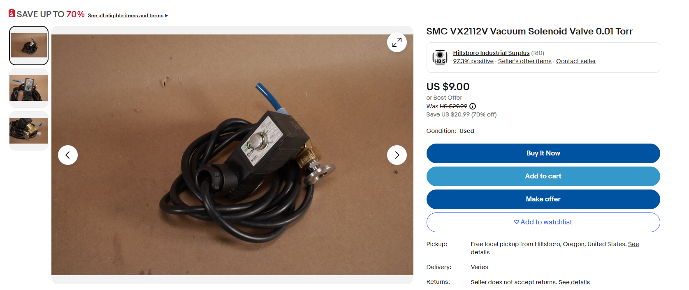
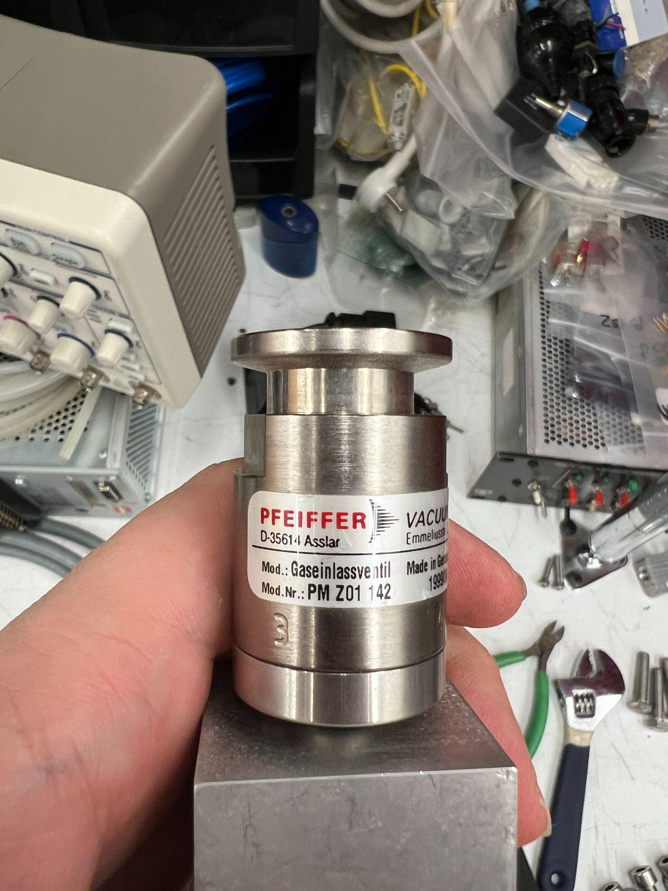
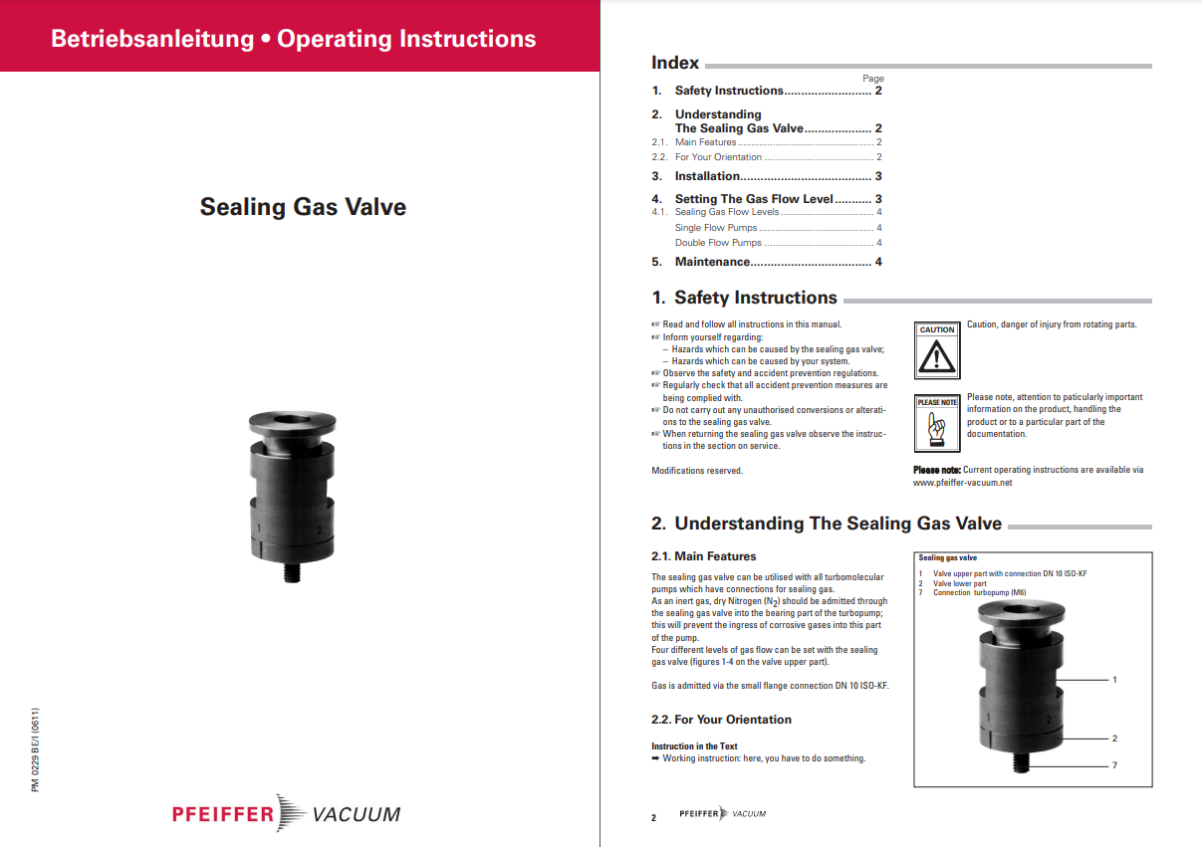
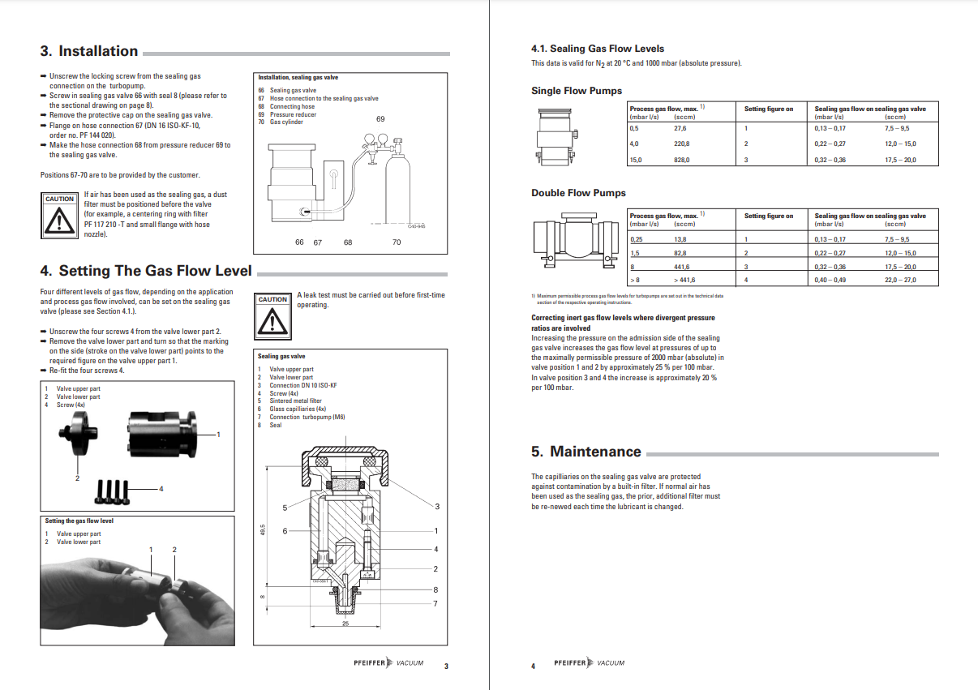
leak
PFEIFFER VACUUM SEALING PURGE VALVE, PM Z01 142, KF 16 FLANGE
VX2112V
https://www.ebay.com/itm/284840023610
PM Z01 142
The Sealing Gas Valve can be used with all Pfeiifer vacuum tubomolecular pumps which have connections for sealing gases.
Sealing gas valve prevents the ingress of corrosive gases into bearing part of the turbopump. The sealing gas valve uses the small flange connection DN 10 ISO-KF; the gas flow can be set with help of this sealing gas valve.
https://www.ajvs.com/pfeiffer-vacuum-sealing-purge-valve-pm-z01-142-kf-16-flange-n-6378

